Slide 1


K.RAMAKRISHNAN COLLEGE OF TECHNOLOGY
(AUTONOMOUS), TRICHY
PASSWORD GENERATOR
PRESENTED BY SUPERVISOR
Nagaraj S Mrs.K.Valli Priyadharshini M.E., (PhD),
2303811710421100 AP/CSE.

Slide 2
PRESENTATION OVERVIEW
Objective
Project Introduction
Problem Statement
Methodologies (Programming concepts relevant to problem statement)
Architecture of the proposed system
List of Modules
Merits
Results and Discussion
Queries

Slide 3
OBJECTIVE
Create strong, customizable passwords based on user-defined criteria.
Include CAPTCHA verification to ensure user validation.
Provide password strength indicators and options to save or copy passwords easily.
Allow users to select password length and character types (e.g., uppercase, digits, special characters).
2/7/20

Slide 4
PROJECT INTRODUCTION
This Java-based Password Generator creates secure, 15-character passwords by combining uppercase, lowercase, numbers, and special characters.
It ensures randomness and meets modern security standards.
The tool simplifies generating robust passwords for enhanced digital protection.
2/7/20

Slide 5
PROBLEM STATEMENT
Design and develop a Password Generator application that helps users create strong and secure passwords.
The application should generate random passwords based on user-defined criteria and ensure that the generated passwords meet security standards.
The goal is to enhance online security by providing users with passwords that are difficult to guess or crack.
2/7/20

Slide 6
METHODOLOGIES
Classes and Objects
Methods
Random Class
loops
Conditionals
2/7/20

Slide 7
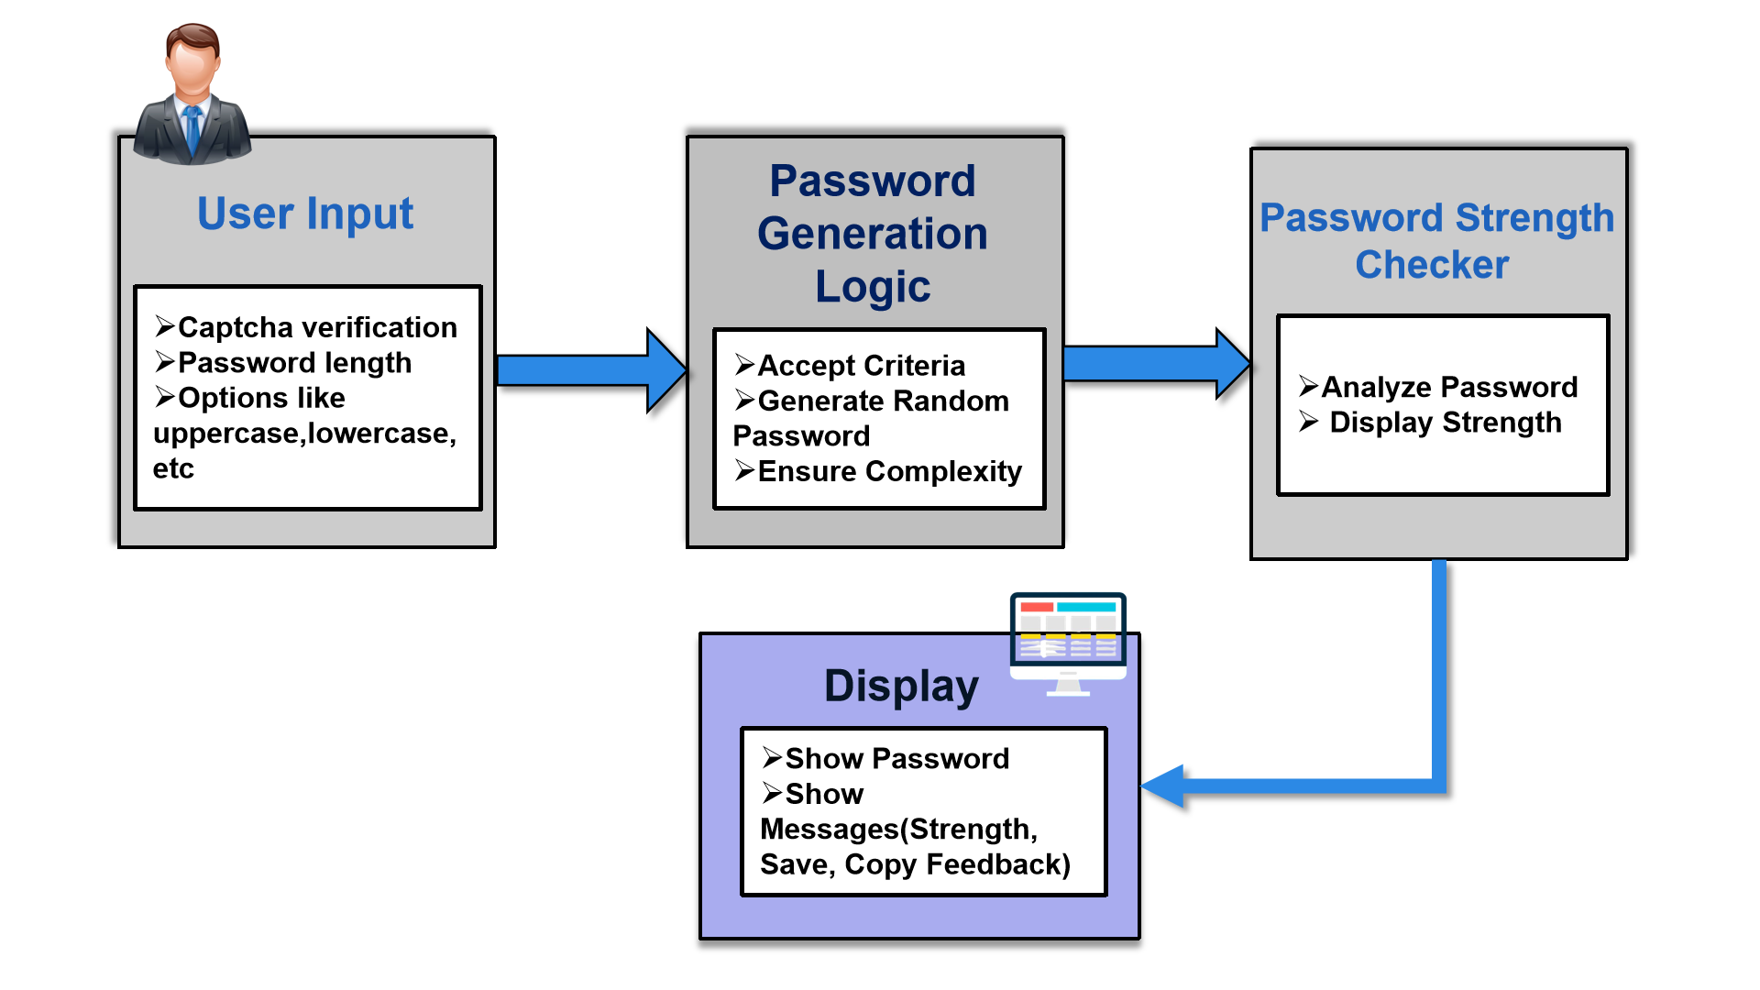
ARCHITECTURE OF THE PROPOSED SYSTEM
2/7/20

Slide 8
LIST OF MODULES
CAPTCHA Verification Module: Ensures the user is human by displaying a simple math-based CAPTCHA for verification before allowing access to the password generator.
Password Generation Module: Creates secure, random passwords based on user preferences like length and character types (e.g., uppercase, digits, special characters).
Password Strength Evaluation Module: Analyzes the generated password and provides feedback on its strength (e.g., Weak, Moderate, Strong) using a progress bar and labels.
Utility Module: Handles supporting tasks like saving passwords to a file, copying them to the clipboard, and displaying dialogs for user actions.
2/7/20

Slide 9
MERITS
Improves Security:
Generates strong, random passwords that are hard to guess or crack.
Easy to Use:
Provides a user-friendly interface with simple options for customization.
Customizable Passwords:
Lets users choose password length and types of characters for flexibility.
Convenient Features:
Includes options to save passwords to a file or copy them to the clipboard.
Ensures Validation:
Uses CAPTCHA verification to prevent unauthorized access.
2/7/20

Slide 10
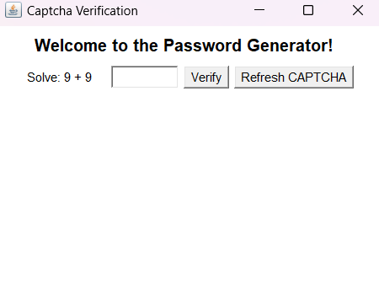
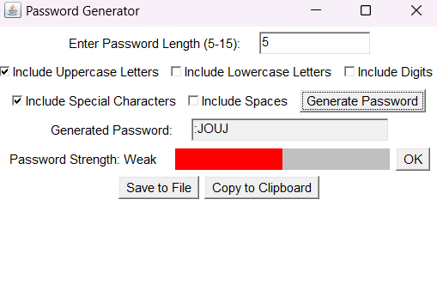
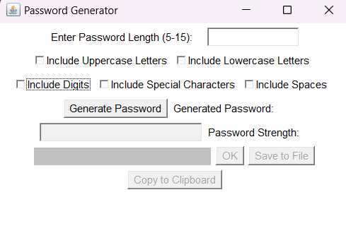
RESULTS AND DISCUSSION
2/7/20

Slide 11
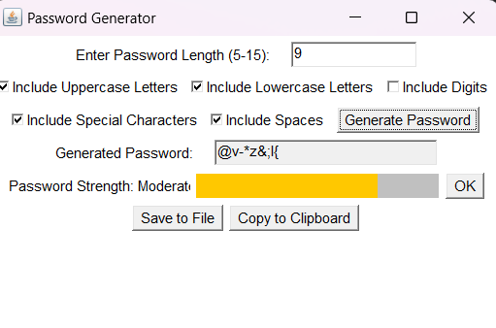
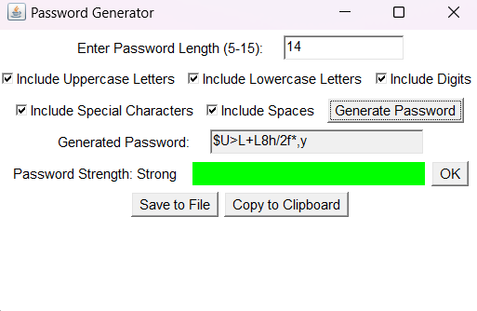
RESULTS AND DISCUSSION
2/7/20

Slide 12
THANK YOU
Queries……?
2/7/20

